Slide 1
TSA Claims Project
Data Preparation and Analysis

Slide 2
Agenda
Introduction
Project Objectives
Data Preparation Process
Data Cleaning Process
Analysis and Statistical Summary
Project Outcomes

Slide 3
The Transportation Security Administration (TSA) plays a critical role in ensuring the safety of travelers across U.S. airports. When property is lost, damaged, or individuals are injured during security screenings, claims are filed. This project focuses on preparing and analyzing TSA Airport Claims data from 2002 to 2017 to support informed decision-making and improve transparency in claim management processes.
Project Introduction

Slide 4
Project Objectives
Data Preparation: Clean and transform raw data from TSAClaims2002_2017.csv by addressing missing values, duplicates, and formatting inconsistencies.
Data Quality Assurance: Ensure compliance with technical requirements, such as correcting column values (e.g., Claim_Type, StateName), handling date discrepancies, and removing redundant columns (County, City).
Standardization: Apply permanent formatting for dates (e.g., *01JAN2000*), currency (e.g., $100.00), and column labels to enhance readability.
Dynamic Reporting: Generate a PDF report that provides an overview of claim trends and a detailed analysis for a user-specified state.

Slide 5
Data Preparation Process
Import the Data
Removing Duplicates
Handling Missing Values

Slide 6
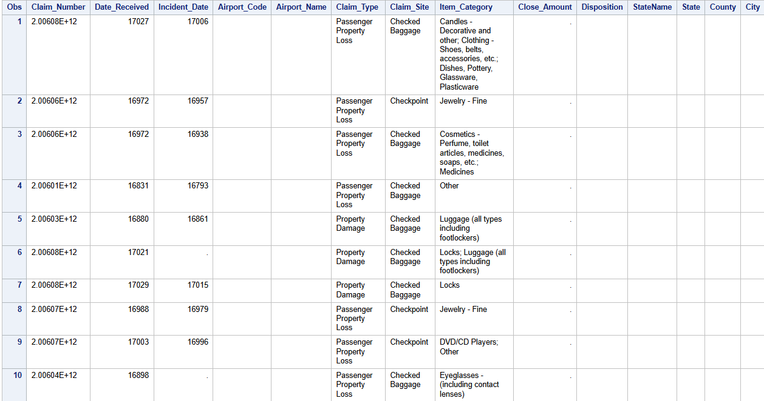
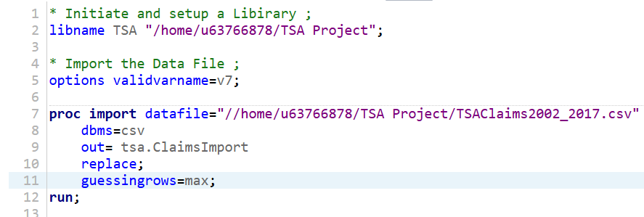
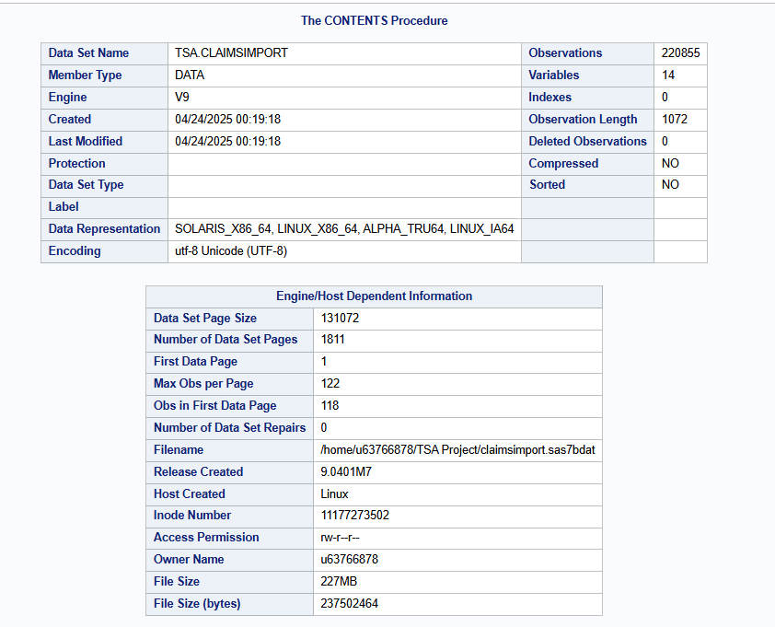
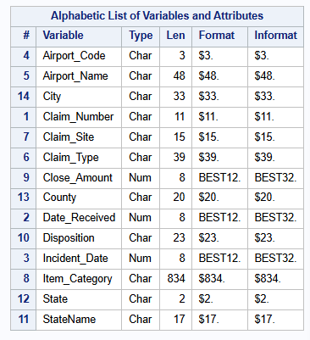
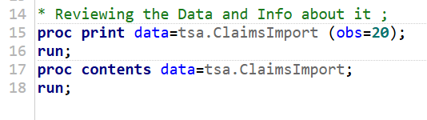
Import the Data

Slide 7
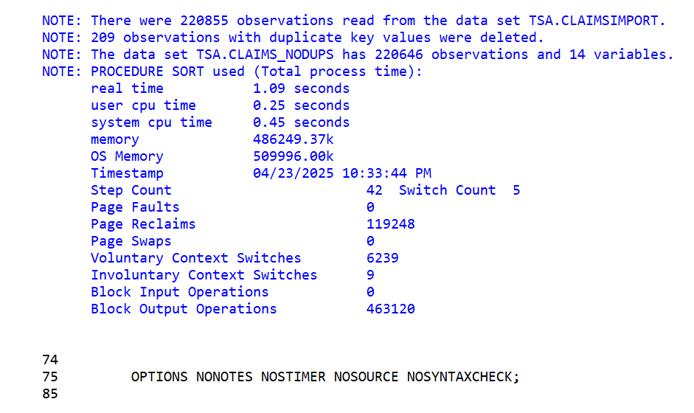
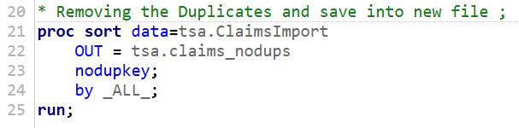
Remove Duplicates

Slide 8
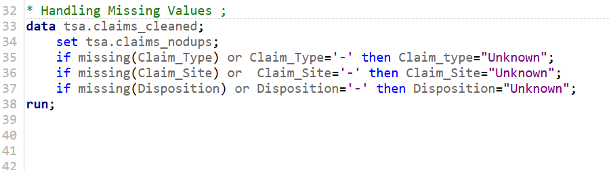
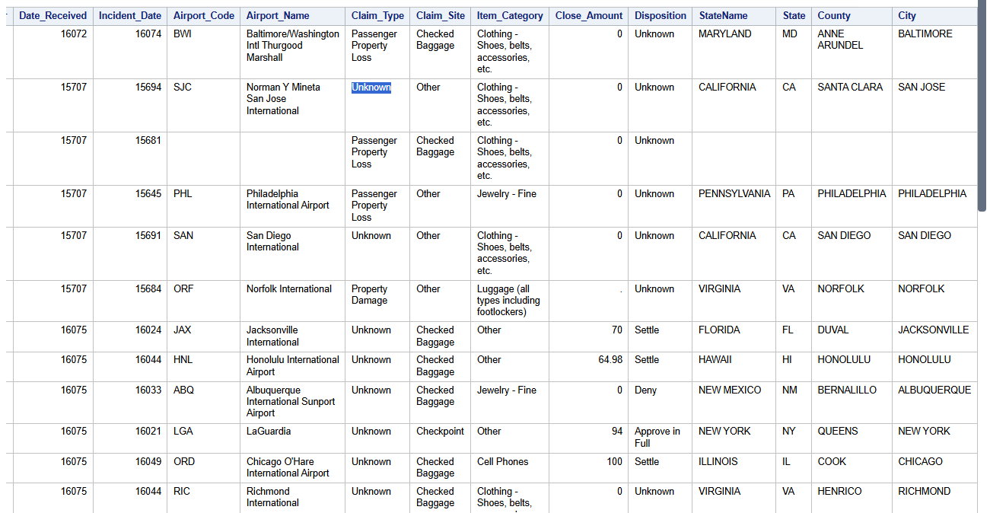
Handling Missing Values

Slide 9
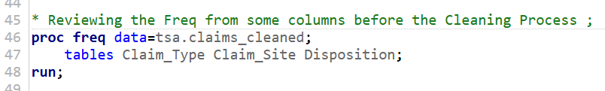
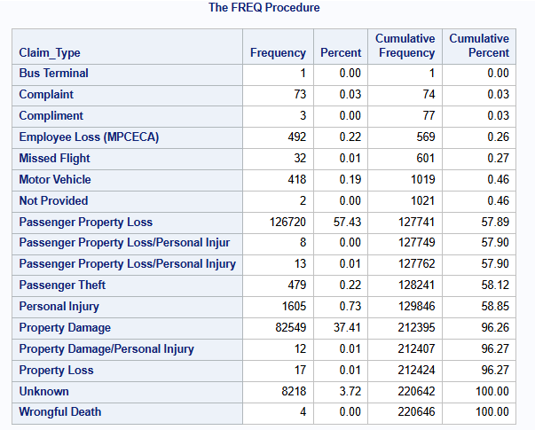
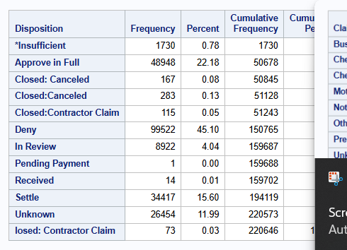
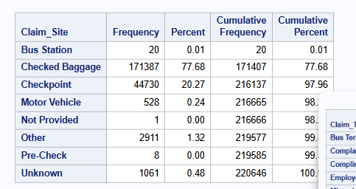
Frequency before Cleaning Process

Slide 10
Data Cleaning Process
Valid Values
Data Formatting
Date Issue Column

Slide 11
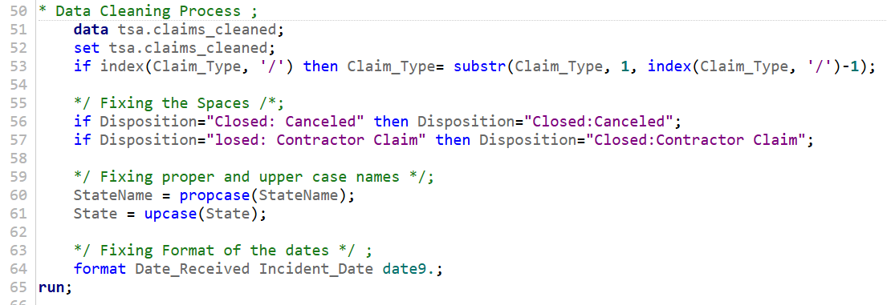
Fixing Spaces, Cases, and Formatting

Slide 12
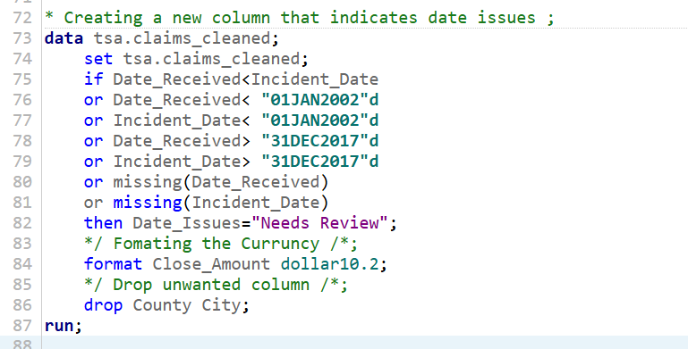
Date Issues and Formatting

Slide 13
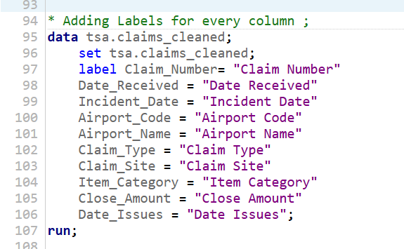
Labeling Columns

Slide 14
Analysis and Statistical Summary
Analysis Questions
Statistical Summary

Slide 15
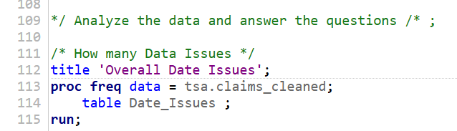
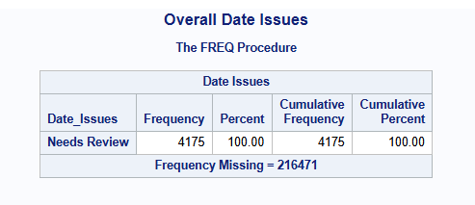
Overall Date Issues

Slide 16
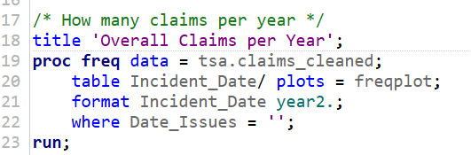
Overall Claims Per Year

Slide 17
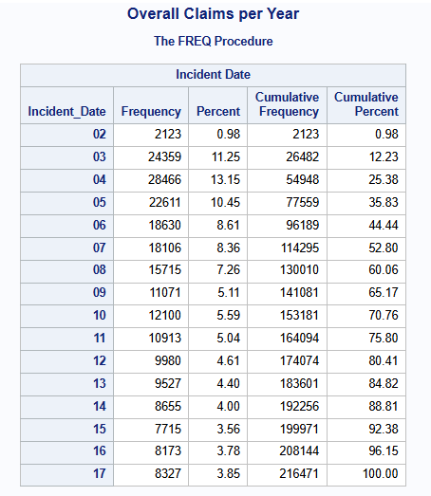
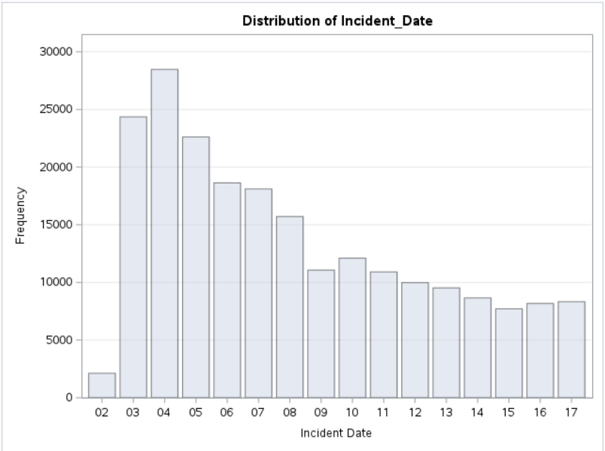
Overall Claims Per Year

Slide 18
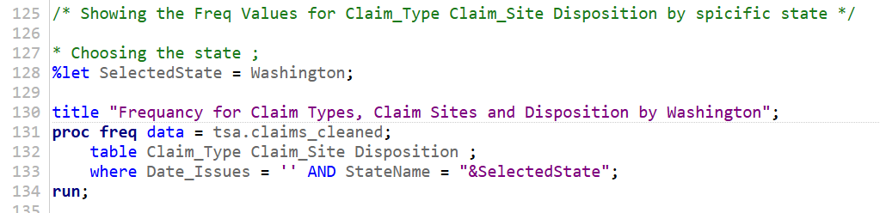
Frequency Analysis

Slide 19
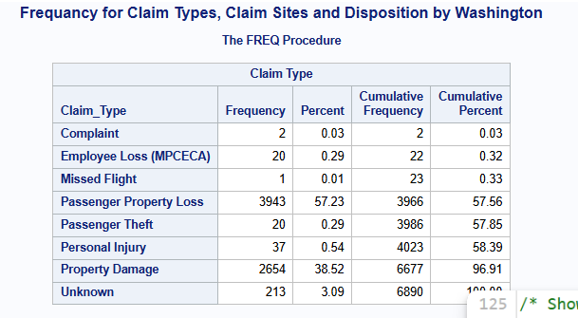
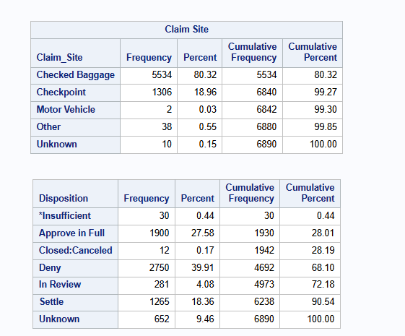
Frequency Analysis

Slide 20
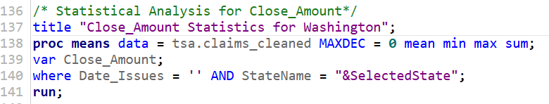
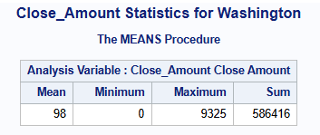
Statistical Summary

Slide 21
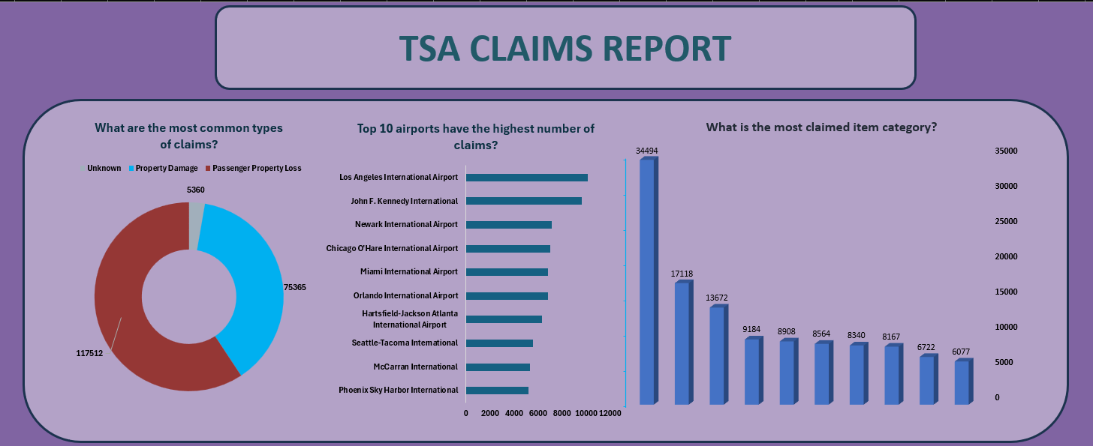
Analysis Dashboard

Slide 22
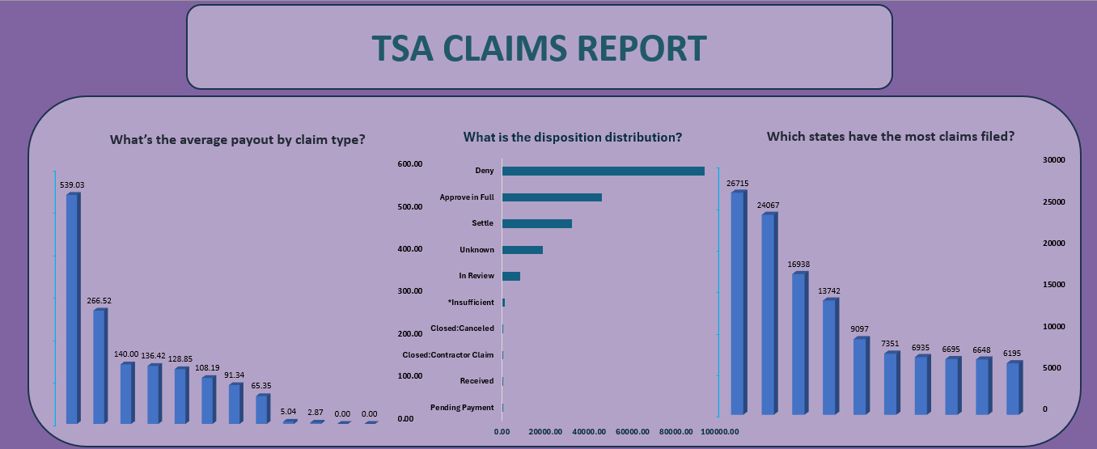
Analysis Dashboard

Slide 23
Project Outcomes
Key Deliverables
Cleaned, standardized dataset ready for analysis.
Insights into claims patterns, date inconsistencies, and financial impacts.
Final report for stakeholders to guide TSA claims management decisions.
Impact
Ensured data integrity for accurate decision-making.
Highlighted trends and anomalies to prioritize operational improvements.
Data Analysis Dashboard

Slide 24
THANK YOU

